Slide 1

HEALTH, WELLNESS & LIFESTYLE MEDICINE
Professor Adrian Kennedy
Notes:
NOTES:
The World Health Organisation defines Health as “not merely the absence of disease, but a state of physical, mental, social & spiritual wellbeing. In this series of slides, we explain the relationship between the way we live (Our Daily Lifestyles) & as a consequence the diseases we get. Lifestyle medicine prescribes the rules for a disease free life, & uses, the components of our daily lifestyle (The food we eat, our daily exercise, sleep etc.) in order to reverse the lifestyle ailments from which many of us suffer.

Slide 2
OVERVIEW
DEFINITION & EXPLANATION
URBAN INDIAN LIFESTYLE SURVEY
W.H.O. CHRONIC DISEASE FACT SHEET
WELLNESS INDUSTRIES
PERSONAL HEALTH SOLUTIONS
COMMUNITY SOLUTIONS
Notes:
NOTES:
During this presentation, we will define & explain the relationship between Lifestyle & Health. We will statistically present the urban Indian lifestyle status, we will present health solutions for both Individuals and the community & we will touch upon the offerings of the wellness industry.

Slide 3
EVOLUTIONARY CAUSES OF DISEASES
PRE-HISTORIC AGE
- Violence, Malnutrition
MIDDLE AGES
- Infectious Disease
MODERN PERIOD
- Lifestyle Disease
3rd February, LIFEMED 2007
Notes:
NOTES:
Tens of thousands of years age during the early periods of man’s existance, the major cause of disease was malnutrition & the major cause of death was injury inflicted by wild animals, or enemies. Men & Women lived for not more than 30-35 years. Soon man gave up his nomadic life & began to live in communities, with animals & livestock. While this protected him from marauding animals & armies, the living in close proximity with man & beast, in non-sanitary conditions created communicable & infectious diseases. As a consequence, in the 10-18th Centuries, while men & women lived till age 45, the major killer was plague, malaria & other infectious diseases. The 19th & 20th centuries brought with it prosperity, automation, the global market place.Man began to use machinary & automobiles, & money was earned sitting in offices, rather than ploughing the field.The lack of physical activity & overabundance of foods from around the world, created its own range of ailments. Obesity, arthritis, HBP, Diabetes & other diseases of a modern prosperous lifestyle.

Slide 4
LIFESTYLE MEDICINE : DEFINITION
The Relationship & Impact Of Day To Day Events On The Illness & Wellness Of An Individual And Its Cumulative Impact On The Community.
Prevention And Treatment Of Disease With Lifestyle Modification.
3rd February, LIFEMED 2007
Source: American College of Lifestyle Medicine
Notes:
NOTES:
Lifestyle medicine is the prevention & treatment of modern, degenerative & lifestyle diseases, through a positive change in lifestyle. In a simplistic way lifestyle medicine advocates daily exercise, a moderate diet, sufficient sleep & relaxation, avoiding health hazards of smoking & also practising safety, as a means maintaining good health.

Slide 5
80 % MEDICAL CARE
COST FACTORS WORLDWIDE
Mortality (Death)
Cardiac
Cancer
Injury
HIV / AIDS
Morbidity (Illness)
Cardiac (HTN, Diabetes)
Cancer
Musculo Skeletal
Psychosoma
Gastrointestinal Problems
Respiratory Problems
SOURCE : WORLD HEALTH CARE
Notes:
NOTES:
While infectious & communicable disease was the major cause of death in earlier centuries. In this century 80% of medicare costs stem from lifestyle related disorders such as HBP,diabetes,arthritis,spondylosis,obesity,asthma,digestive ailments,anxiety,depression etc. While these are the major causes of hospitalisation & medication; lifestyle ailments such as heart attacks, cancers & injury due to automobile accidents are the major cause of death.

Slide 6
AILMENTS (CO-RELATION) CAUSES
Alcohol/ Diet Sedentary Stress
Smoking
* * * *
* * * *
* * * *
* * * *
* * * *
* * * *
* * * *
Cardiac
Cancer
Joint Problem
Psychosoma
Digestive Problem
Respiratory Problem
Injury / Accident
Inappropriate Lifestyle is associated with 80% of
Medicare costs. A high fat diet, sedentary Lifestyle,
high level of Stress, Alcohol & Smoking are either
causative or an aggravating factor in most ailments.
SOURCE : WORLD HEALTH CARE
Notes:
NOTES:
If we were to locate the cause of these lifestyle ailments, we would see that high levels of stress & mental tension, low levels of physical activity & exercise, over abundant food & a high fat commercial diet, & alcohol, & smoking, coupled with lack of safety practices & automobile accidents are the major causes of lifestyle ailments.

Slide 7
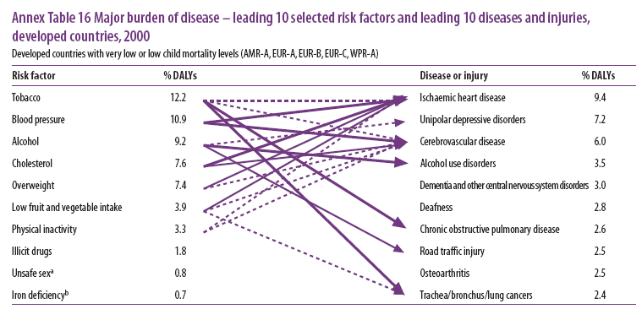
DISEASE TREND – DEVELOPED WORLD
DISEASE TREND –
DEVELOPED WORLD
Notes:
NOTES:
Research pertaining to the disease trend in the developed world (America,Europe,Japan) lists the major risk factors of disease or injury as tobacco,smoking,alcohol,obesity,physical inactivity, unsafe sex etc.Add to this Blood Pressure, diabetes & cholesterol,& you get a disease pattern of heart attack ,depression, respiratory problems,Dementia,road traffic injuries & cancers.

Slide 8
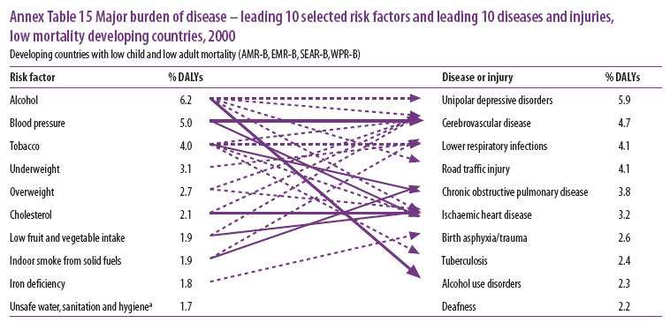
DISEASE TREND – DEVELOPING WORLD
DISEASE TREND –
DEVELOPING WORLD
Notes:
NOTES:
A look at the disease trend of the poorer developing Economies (India, South America, Asia) interestingly also shows a lifestyle association of alcohol, tobacco, malnutrition & poor hygiene, resulting in depression, neurological disorders, respiratory infection, heart diseases & tuberculosis.

Slide 9
THE URBAN INDIA HEALTH & LIFESTYLE SURVEY(1995)
FACTORS (%)
Physically Unfit
Overweight
Multi Dimentional Stress
Psychosomatic Stress
Smoking
Family History
High Cardiac Risk
Multifactor Cancer Risk
55.98
64.67
41.24
84.79
20.02
42.37
67.08
29.78
SOURCE : MASTER HEALTH CHECK-UP, APOLLO HOSPITALS
Notes:
NOTES:
I have had the good fortune of evaluation, the lifestyle of tens of thousands of individuals for several decades starting from 1990.Perhaps India’s first Health & Lifestyle survey was the Apollo Hospitals Master Health Check Survey of 1995,covering about 100,000 clients from the various metros.(Chennai,Hyderabad,Delhi,Bangalore etc.).The statistics in the slide, speaks for itself.

Slide 10
URBAN INDIA HEALTH PROFILE
FACTOR | 2000/4 | 2005/8
Physically Unfit | 70.25 | 67.03
Overweight | 72.08 | 61.03
Multi Stress | 24.34 | 12.18
Chronic Stress | 82.30 | 59.14
Smoking | 17.33 | 11.83
Alcohol | 32.22 | 19.00
Cardiac Prone | 65.66 | 51.49
Notes:
NOTES:
The decades up to the year 2000,saw no serious acceptance of lifestyle medicine by the medical fraternity & the community as a whole ,& our research for the period 2000/2004 saw Lifestyle at its worst, with physical inactivity logging in at 70% ,obesity / overweight at 72% ,stress at 82% & Multifactor cardiac risk at 65%.The acceptance of Lifestyle medicine & wellness management post 2005,along with ,TV advertisement & print publicity saw improvement for the period 2005 to 2008.

Slide 11
THE URBAN INDIA HEALTH & LIFESTYLE SURVEY
Healthy With
Appropriate 15.00%
Lifestyle
SOURCE : MASTER HEALTH CHECK-UP, APOLLO HOSPITALS
Notes:
NOTES:
Nevertheless, less than 15% of the urban Indian Population actually has an appropriate lifestyle, of moderate diet, daily exercises, manageable stress, sufficient sleep, moderate alcohol & no smoking.

Slide 12
WEALTH & WELLNESS
PARAMETERS CEO EXEC SUPERVISORS WORKERS
Obesity 82 54 28 18
Unfit 69 57 54 56
Stress 100 34 53 --
High B.P. 35 20 11 2
Diabetes 12 17 5 4
Cholesterol 23 8 3 --
Cardiac 58 48 34 18
Alcohol 15 3 4 5
Smoking 15 18 15 14
Paan 2 11 17 42
Cancer 30 29 41 33
Good Health Index 40 55 57 68
SOURCE : Medical Check-up 95, VIP 95, MHS/Coke Ovens Check-up-97-98
Notes:
NOTES:
An interesting study done by me in Tata Steel during the period 1990-1995.Covering all levels of the workforce clearly established that the lower paid factory workers was healthier than his office bound, better paid colleauges.As a matter of fact, it was established that a higher salary and a sedentary ,stressful job predisposed you to higher cardiac risk & poorer health.

Slide 13
URBAN INDIA ADULT / CHILD
HEALTH & LIFESTYLE SURVEY
PARAMETERS
ADULT *
CHILDREN **
Stress 41 54
Psychosoma 84 11
Sedentary 55 72 Obese 64 52
Dependency Risk 29 52 Safety Risk -- 60 Wellness Status 15 --
* 100,000 adults. 10,000 Children.
Notes:
NOTES:
The two aspects of my job are, corporate wellness & School Health,& when I compared the health of school children & adults,I have consistently found children to have higher levels of stress & lower levels of physical activity. Add to this their early exposure to smoking, alcohol & drugs & you will have a growing burden of health care costs in future years.

Slide 14
INTERNATIONAL HEALTH
COMPONENT
AUSTRALIA%
USA
%
In Active 43 40
Over Weight 62 59
Stress 13 55
Chronic Ailments 77 -
Diabetes 14 -
Cardiac Problems 73 69
Smoking 23 28
Alcohol 13 9
Source: Australian Bureau of Statistics
Notes:
NOTES:
In earlier slides we reviewed the urban Indian Health Status & when compared with advanced countries such as Australia, & the USA we notice that our health is worse, With the attention developed countries are paying to lifestyle change, the trend there is getting better & all we need to do is follow their examples.

Slide 15
FACTS ABOUT LIFESTYLE
RELATED CHRONIC DISEASE
World Health Organization (WHO) 2005
The Major Risk Factors For Lifestyle Disease Are An Unhealthy Diet, Physical Inactivity, And Tobacco Use
Around The World, Lifestyle Disease Affects Women And Men Almost Equally
Children Are More At Risk Than Adults For Lifestyle Maladies
Notes:
NOTES:
In 2005 ,the WHO released a fact sheet co-relating Lifestyle with chronic disease, stating that the major risk factors for Lifestyle diseases were an inappropriate diet, physical activity & smoking,& that, these Lifestyle maladies affected both men & women & also children with equal impunity.

Slide 16
FACTS ABOUT LIFESTYLE
RELATED CHRONIC DISEASE
World Health Organization (WHO) 2005
Lifestyle Disease Was Responsible For 80% Of All Deaths Worldwide.
Almost Half Of Lifestyle Disease Deaths Occur In People Under The Age Of 60.
Lifestyle Disease Deaths Account In More Than 60% Deaths In Low And Middle Income Countries.
Notes:
NOTES:
The fact sheet mentioned that Lifestyle diseases accounted for 80% of all medicare costs & that deaths frequently occurred in persons below the age of 60.Deaths at this early age impacts national productivity & family income. The WHO fact sheet also emphasised that modern lifestyle (automobiles, TVs etc.) had also permeated into poorer countries, resulting in low levels of physical activity & a sedentary life in these locations ,resulting in lifestyle affliction in developing & undeveloped countries also.

Slide 17
PERSONAL SOLUTIONS
HEART ATTACK !!
MEDICAL & HEALTH
CHECKUP
INJURY
AVOID
DEPENDENCY
MANAGE STRESS
EXERCISE
NUTRITION
SAFETY
HIV / AIDS
CANCER !!
Notes:
NOTES:
So with these being the facts, what are the solution to the major modern killers, the Heart attacks, cancers, automobile deaths & HIV/AIDS? The solution for each individual is, first, to have an annual medical checkup, to identify ailments such as HBP, & diabetes early. Any ailment including cancer if detected early can be more easily cured. Second, to eat the right food in the right quantities.A balanced & moderate diet, Food eaten in excess & a lack of daily exercise causes obesity ,so the third rule, to do a half hour of moderate exercises daily in order to manage weight & maintain overall health.Four,Sleep & relaxation are vital to managing stress, tesnions, & the consequent psychosomatic outcomes. The fifth rule is to quit smoking which causes cancer & other ailments & to manage alcohol. Finally to adhere to the rules of safety at all times including automobiles & sexual safety.

Slide 18

COMMUNITY SOLUTIONS
Health, Wellness & Lifestyle Professionals
Medical & Health Check-up
Health Management Education
Health Wellness & Lifestyle Facilities
From Curative: Augmentation & Sophistication Of Medical Facilities
To Preventive: Management & Control Of
Lifestyle Factors
3rd February, LIFEMED 2007
Notes:
NOTES:
If these are the general guidelines of Lifestyle medicine for the individual, how can this translate to the community? Firstly we need a cadre of lifestyle medicine professional. (This can be sourced from Medical & Health professional).Second, Governments & corporates need to encourage low cost medical & health screening at the ratio of once a year for adults over 30.Thirdly,we need to infiltrate health education into the community. Talks in schools & corporates on Nutrition, Exercise & Stress Management etc.And finally we need as many wellness facilities (Gyms, Spas, Stadiums, walking parks, cycling tracks etc.) as there are hospitals & medical clinics. The Government & societies objective should be preventive, rather than curative. That is to prevent disease, rather than to cure it after it surfaces.

Slide 19
APPROX COST OF POOR HEALTH
U.S.A. - MEDICAL BUDGET - $ 2.5 Trillion Per Annum
- $ 5 Billion Per Day
INDIAN MEDICAL BUDGET - Rs. 100,000 Crores Per Annum
- Rs. 300 Crores Per Day
AUSTRALIAN MEDICAL
BUDGET -AUD 50 Billion Per Annum
- AUD 100 Million Per Day
HEALTH COST FORMULA
QUANTIFIABLE COST - 100% Medical Cost
INTANGIBLE COST - 3% Of Turnover (+/-)
RETURNS - 1:5
Notes:
NOTES:
And why the pressing need to do this. Because illness is expensive as on 2010-2015, the annual Medical Expenditure in the USA was over 2.5 Trillion Dollars. The Indian Medical Budget is in excess of 100,000 Crores & these budgets are spriralling out of control.

Slide 20
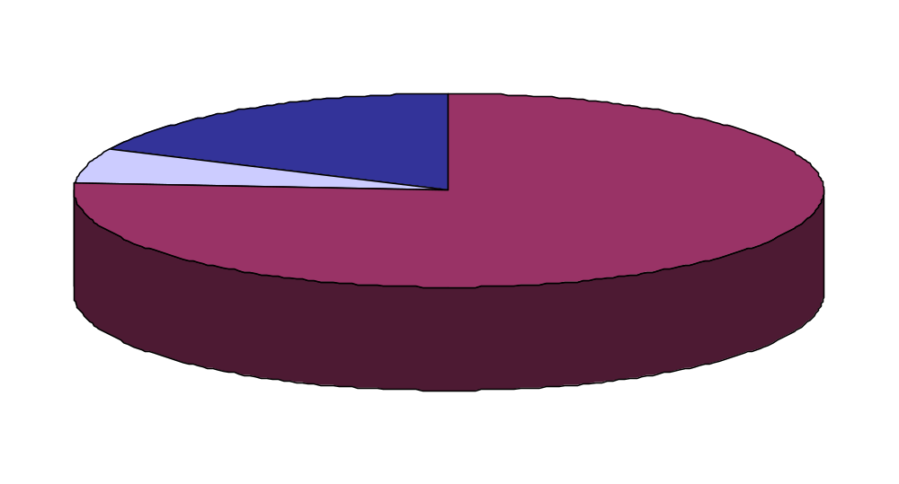
“TOTAL COST” OF POOR HEALTH
Medical (18%)
Lost Productivity (76%)
Disability (6%)
Medical & Disability, Account For
Only 24% Of Health & Productivity Costs
Source: Integrated Benefits Institute (2001)
Notes:
NOTES:
But medicare costs are only a fraction of the actual financial impact of poor health. The major cost factor at 75:25 is lost productivity due to ill health.

Slide 21
RELATIONSHIP BETWEEN
DISEASE AND ECONOMIC GROWTH
Disease
Absenteeism, early retirement,
morbidity and mortality
Shorter lifespan and rise in the
rate of time preference
Lower labour
productivity
Higher
Medicare costs
Higher consumption and lower
rates of savings and investments
Lower national income
and stagnant growth
Notes:
NOTES:
Illness results in absenteeism from work & also lower productivity if at work. This results in a lower income & salary & greater expenditure on medication. This results in loss of savings & quality of life, which in turn makes disease unmanageable. It is a vicious cycle.

Slide 22
WOW !! USA
(WORKING ON WELLNESS)
Hospitals
Mayo Clinic – 16 Clinics Covering 100,000 MHC Annually
Corporates
American Heart Association
- Registered Corporates 10000 Covering 6 Million Persons
General Motors - 1.6 Million Persons
Financial Benefits
Sara Lee Corporation; Reduced Medicine Costs @ $150 For
250000 Employees A Saving Of $3.75 Million
AT&T (USA) Lower Insurance Claims @ $40 For 350000
Employees A Saving Of $14 Million
Source : Wellness Programs Management 1999
Notes:
NOTES:
If these are the problems facing the community & governments what is being done a about it.In the United States where Lifestyle medicine is being championed by the American Heart Association, the American Council of sports medicine etc, the emphasis is to ensure a return on investment; meaning monies spent on health, should give a return on productivity. The financial benefits & savings as a consequence runs into millions of Dollars & examples abound in research articles.

Slide 23
WOW !! SINGAPORE
Health Promotion Board
School Health Programs
Work Place Health Promotion
Corporates
Glaxo
Dupont
Motorola
Civil Aviation
Police
Programs
Health Screening, Counseling, Audit
Health Programs & Education
ACTIVE Programs & Sports
FAVE Food & Canteen
SHE (Safety Health Environment)
Ergonomics
Wellness Participation Vouchers /Memberships
Health Awards For Improved Health
Source: Workplace Health Promotion Board
Notes:
NOTES:
Singapore is a text book example of Lifestyle Medicine with the introduction of School Health & Corporate wellness. That is, introducing lifestyle change into the organized sectors of Schools & corporates that account for the majority of lives. Health Screening, Health Education, Encouraging physical fitness, smoking cessation programs etc. are the norm in all institutions.

Slide 24
WOW !! AUSTRALIA
Australian Better Health Initiatives.
Go For Your Life Programs
Healthy Lifestyle Choices.
Healthy School Programs
Supporting Seniors
Promotion Of Walking & Cycling
Chronic Disease Prevention
Obesity & Physical Activity Programs
Health Action Plan
Source: Victoria Queensland Ministry of Health
Notes:
NOTES:
Australia seems to have adopted the community approach to lifestyle change, with the government, educating the public through TV & Newspaper campaigns, on better health initiatives, Healthy lifestyle choices, seniors fitness programs, school health programs etc.Also the creation of health infrastructure including cycling & walking routes etc.

Slide 25

FROM ILLNESS TO WELLNESS
WOW! INDIA
SEGMENT | PRODUCT / SERVICES
ALLOPATHY | Pharmacies, Diagnostic, Dental, Eye, Cosmetic Surgery
ALTERNATIVE THERAPIES | Ayurveda Treatments and Products
NUTRITION | Health Foods and Supplements
REJUVENATION | Spas and Yoga Centers
FITNESS AND SLIMMING | Gyms and Slimming Centers
BEAUTY | Cosmetics, Hair, Skin, Salons
COUNSELING | Psychological, Academics, Corporate, Schools
SOURCE FICCI / E&Y
Notes:
NOTES:
The Indian thrust to health improvement, is at best fragmented & powered by private enterprises with the government rightly concentrating on health at the level of the village. Research analysts have pegged the wellness industry in India at Rupees 50,000 Crores covering, diagnostic clinics, cosmetic surgery, Ayurveda products, yoga centers, Spas, gyms, & fitness centers, health food products & even corporate & school health.

Slide 26

SOME WELLNESS PLAYERS
COMPANY | PRODUCT / SERVICES
APOLLO HOSPITALS MANIPAL HOSPITALS | Diagnostics, Pharmacies, Clinics and Counseling
HLL DABUR | Ayurveda Clinics Ayurveda Products
AGROTECH FOODS ITC FOODS | Oils, Popcorn Atta, Flour
OBEROIS TAJ GROUP | Hotels and Spas Hotels and Spas
TALWALKARS VLCC | Gyms and Fitness Slimming Centers
KAYA LAKME | Skin Clinic Cosmetics Products
RELIANCE | Wellness Stores and Products
WOW! INDIA
Source: FICCI / E&Y
Notes:
NOTES:
The Institution that are championing the wellness & lifestyle medicine drive include, Apollo Hospitals with Medical Screening, Dabur with its Ayurveda products, ITC food division with its multigram cereals & heart friendly oils, the Taj & Oberoi groups with their spas, Talwalkers with its gyms, VLCC with its slimming centers, Kaya & Lakme with their skin care & hair products & also Reliance with its wellness apparel stores, to mention a few.

Slide 27
THANK YOU
PROF. ADRIAN KENNEDY
(Chief Wellness Officer)
Arabian Wellness & Life Style Management
(Arabian Healthcare Group Initiative)
(RAK Hospital)
Ras al Khaimah, UAE
Mob: 0502215234
Email: prof.kennedy.aj@gmail.com
Notes:
NOTES:
I do hope that this presentation has given you some ideas of what lifestyle medicine is.It is the use of our daily lives & routine in order to live a healthy life. And in case we get sick or have a heart attack or get cancer, it is the lifestyle changes we introduce in order to accelerate our healing. Thank You.

